Slide 1
Precision in Freeze-Drying: Continuous Vial Mass Monitoring
Team: Elijah Bell, Xavier Bell, Umesh Padia, Sebastián Ruiz-Lopera, Liane Xu
Mentors: Professor Alex Slocum, Dr. Steven Burcat, Rohan Kadambi, Dr. Elena Kalodner-Martin
May 12, 2025
Lyophilization
2.750 Medical Device Design

Slide 2
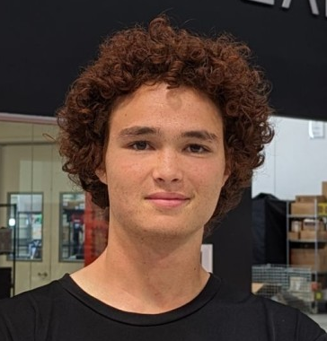
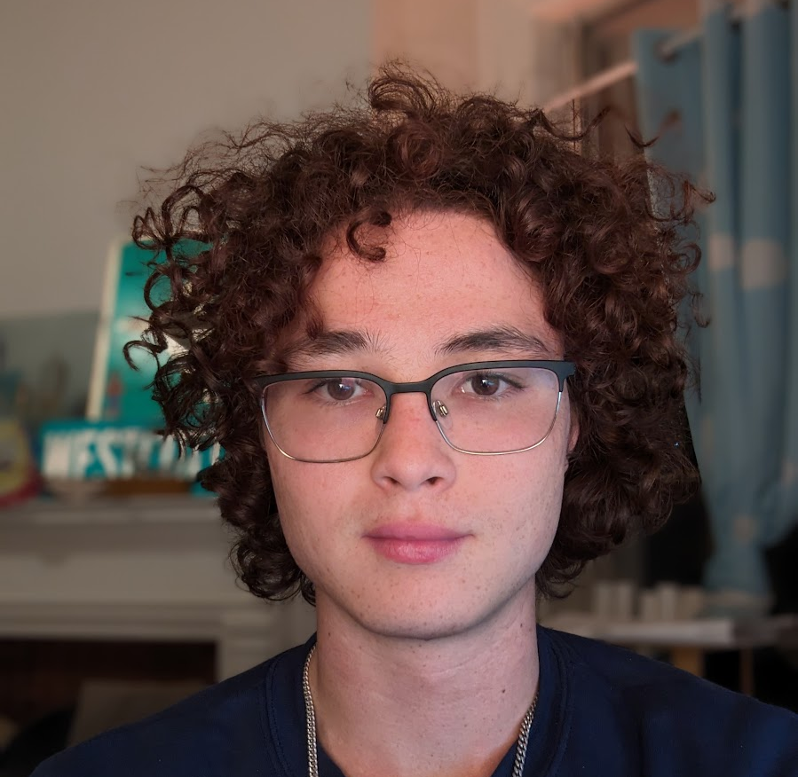
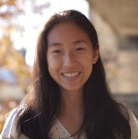
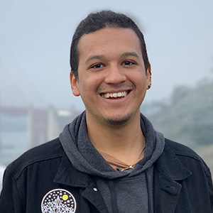
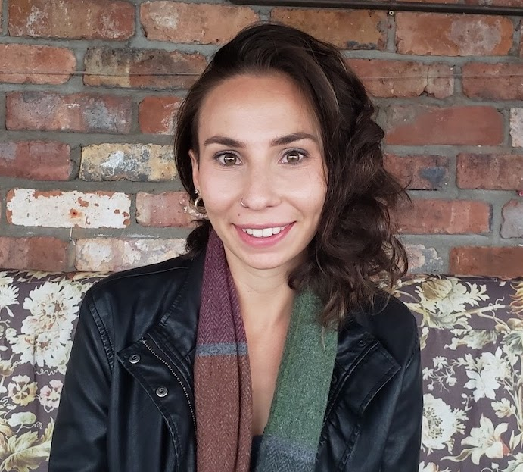
Team
Elijah Bell
2025, 2A
Xavier Bell
2025, 2A
Liane Xu
2025, 2A, 6-4
Umesh Padia
PhD, EECS
Sebastián Ruiz-Lopera
PhD, EECS
Prof. Alex Slocum
Mentor
Dr. Elena Kalodner-Martin
Communications
Dr. Steven Burcat
Mentor
Rohan Kadambi
Mentor

Slide 3
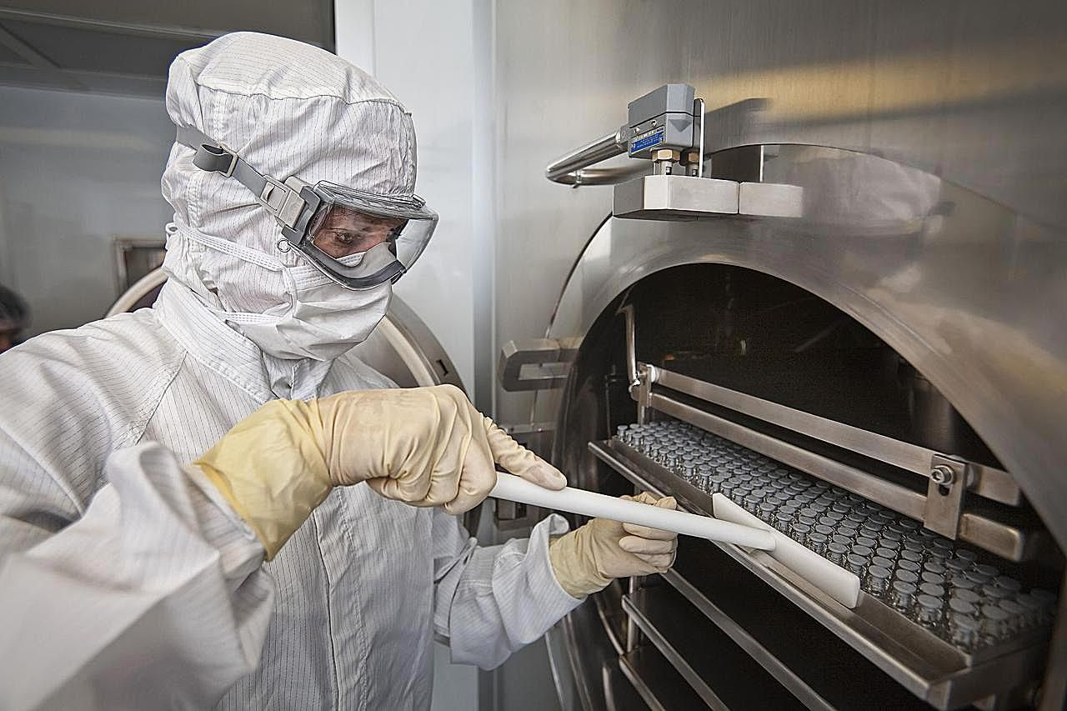
Lyophilization Background
Lyophilizing or freeze-drying medical products is a common multi-stage process to remove water performed to extend the shelf life of pharmaceuticals.
Traditional batch lyophilizing over dries the product to ensure all water has been removed. Although coarse batch level sensing exists, differences between vials mean hours or days are wasted over drying vials and developing lyophilization procedures.
Hours to days
~ 95% wt water
~3 g water
< 2% wt water
< 3 mg water

Slide 4
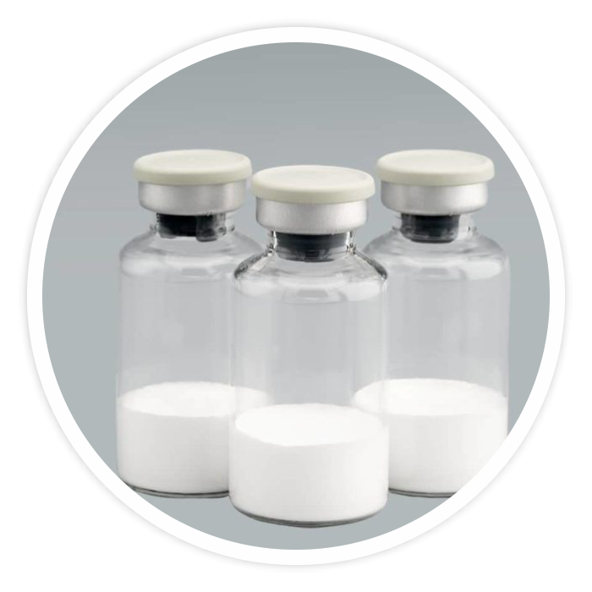
Mission Statement
Develop an individualized water content measurement method with 1 mg precision for batches of vials undergoing lyophilization.
In pharmaceutical manufacturing, individual mass monitoring has the potential to increase production throughput of medicine by providing more control over the manufacturing process.

Slide 5
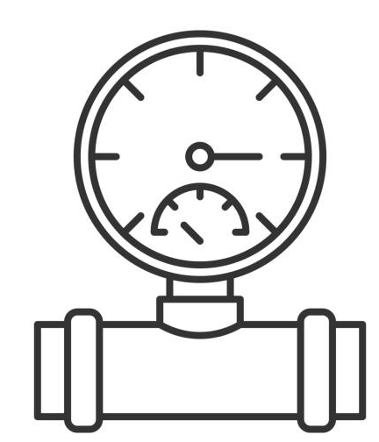
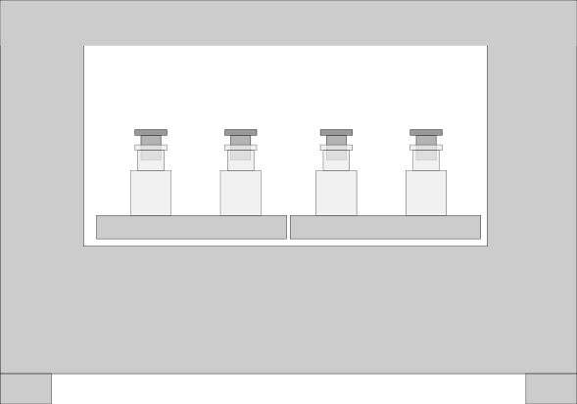
Functional Requirements
1 Milligram Sensitivity & Repeatability
Individual Mass Measurement
?
?
?
Geometric & Environmental Compatibility
Non-Destructive & Sterile
-40° to +25°C
0.03 to 101 kPa
Notes:
Extreme temperature and pressure changes. Also fit into existing continuous lyophilization chamber.
Sterile to not affect pharmaceutical product.
The sensing system must tolerate temperatures as low as −40C and a vacuum environment.
The sensor must provide individual vial data independent of the vial properties.
The sensor must resolve the final mass of water in a lyophilized cake. The specific mass value varies according to the specific application, and is typically O(1mg).
The sensing system must accommodate moving vials through a lyophilizer.
The sensing system must be compatible with a vial pick-and-place system.
The sensor must be nondestructive and sterile.

Slide 6
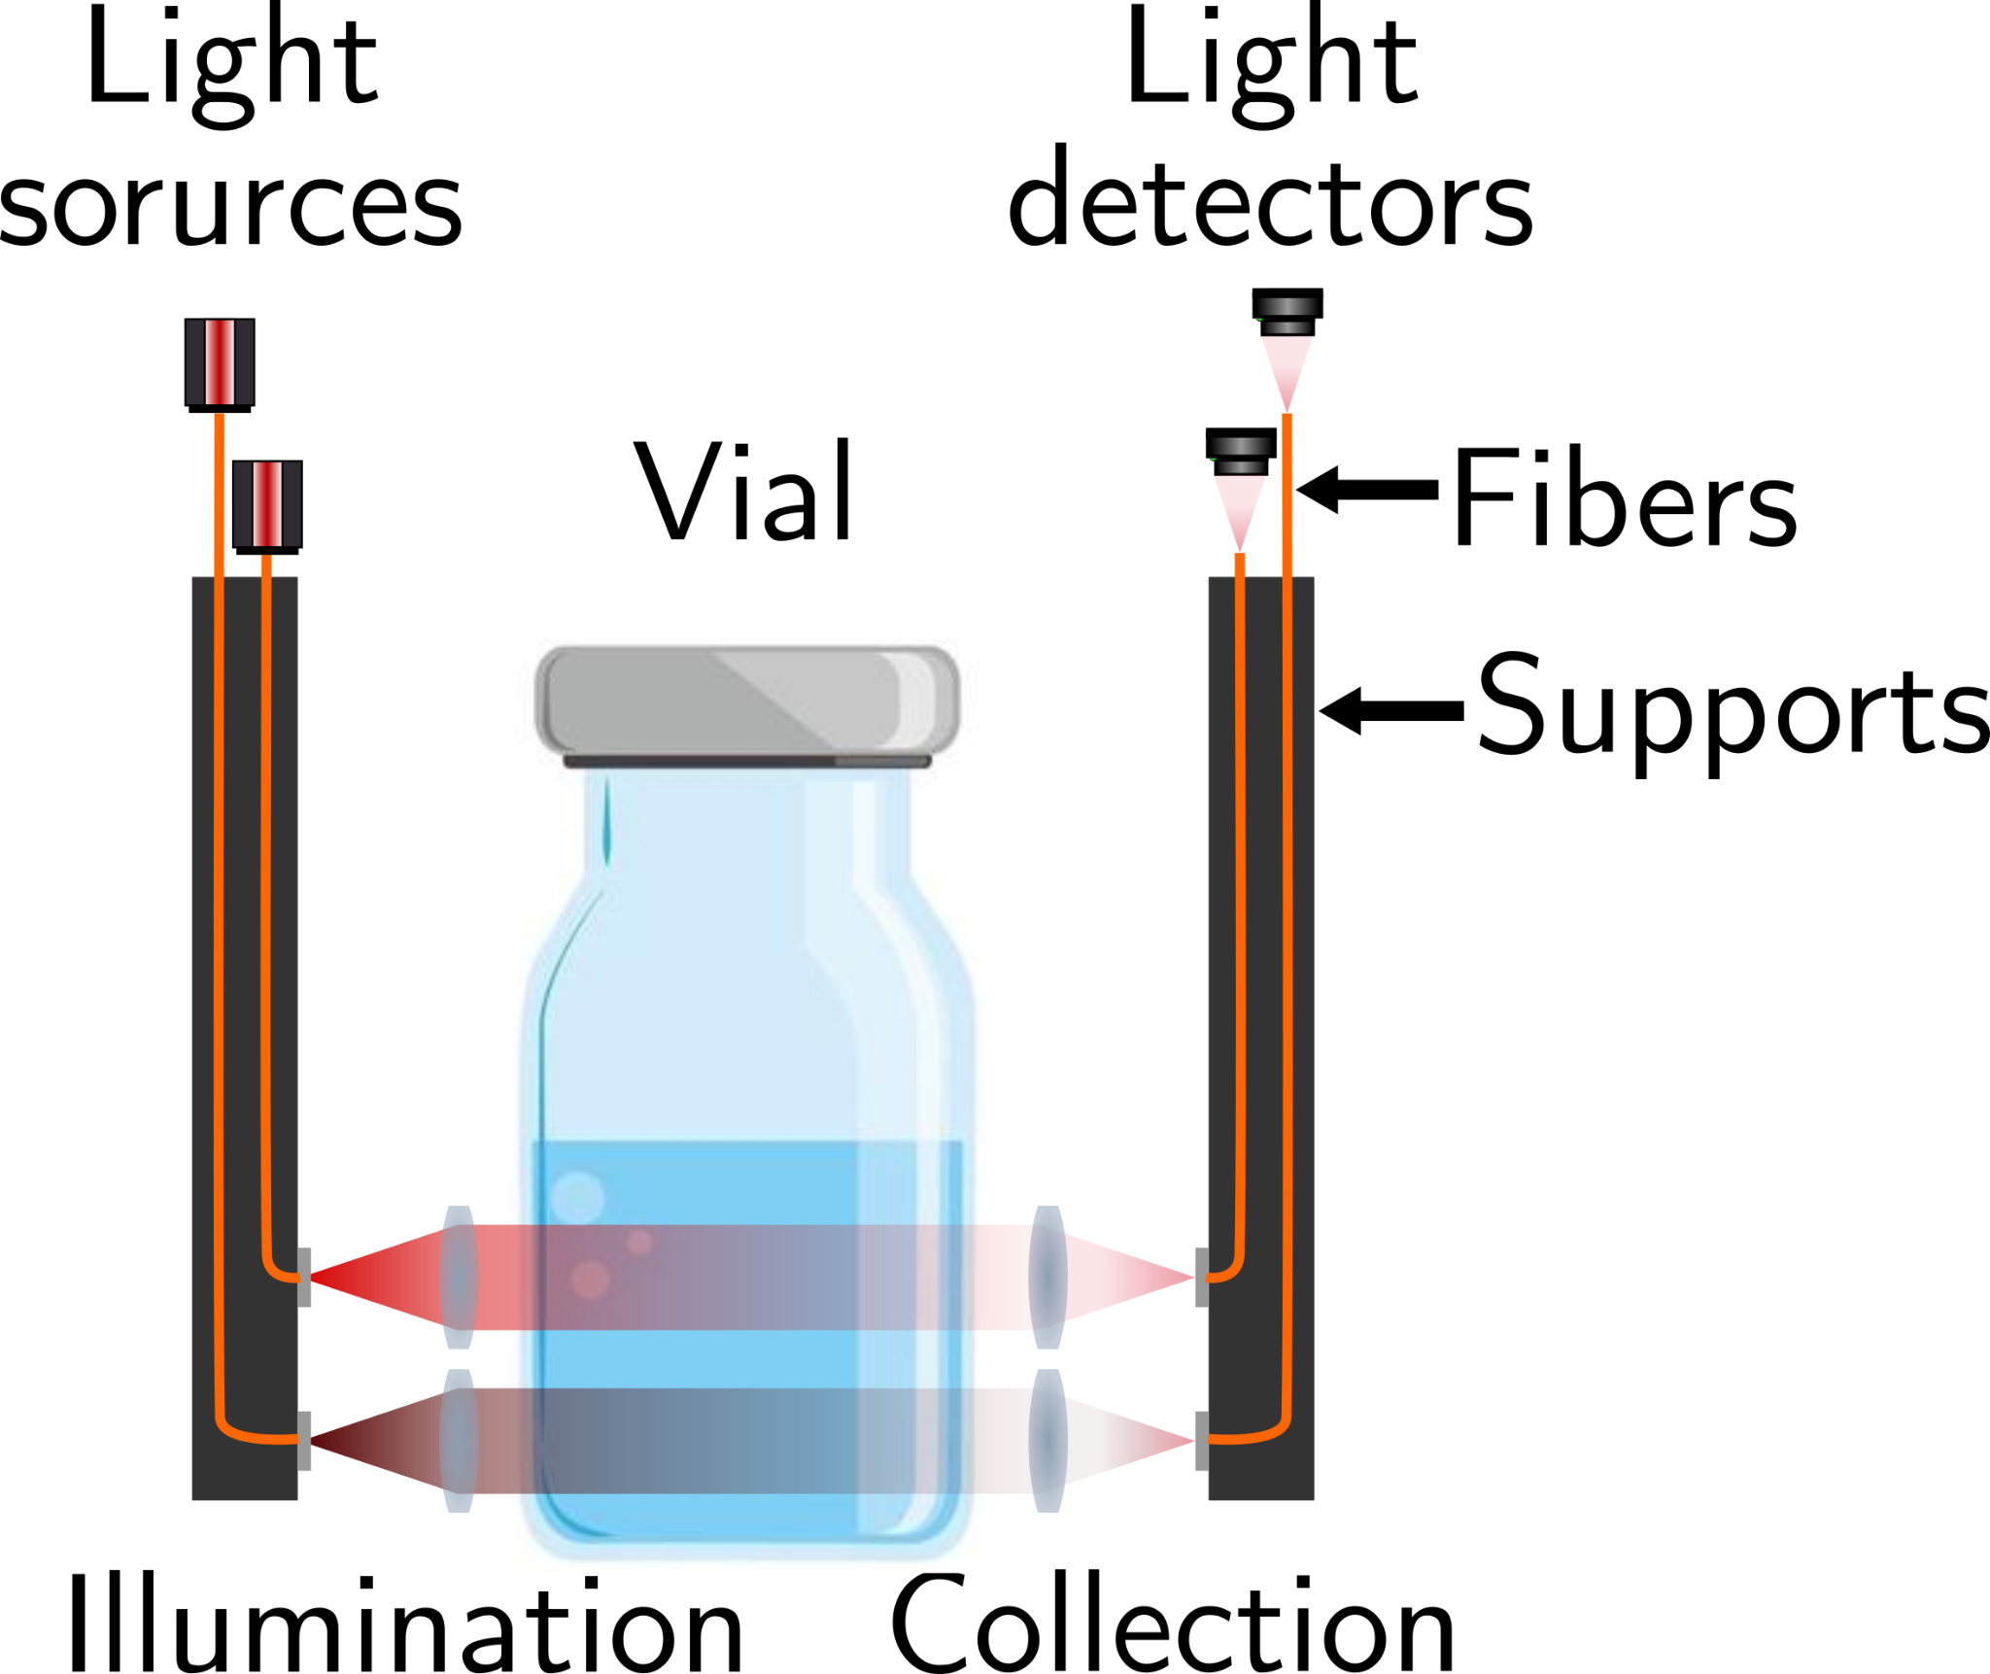
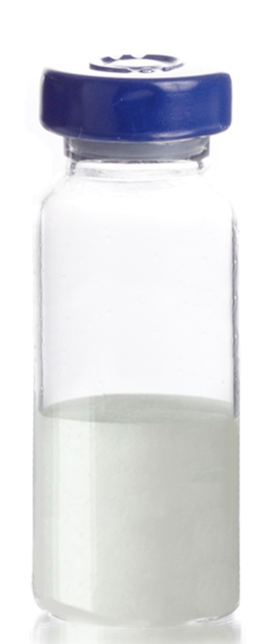
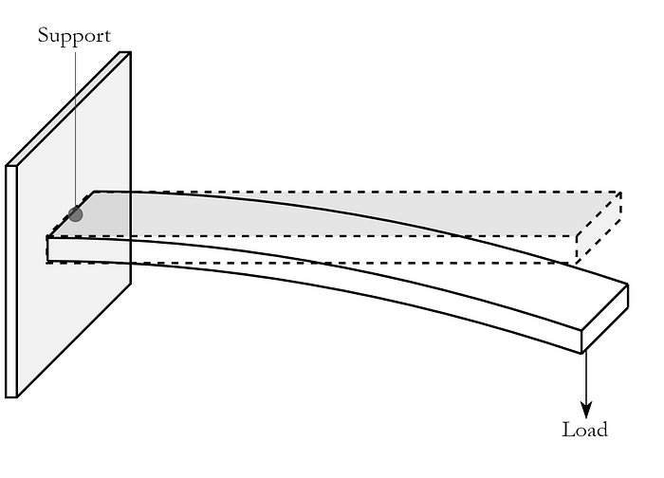
Considered Strategies
Spectroscopy
Capacitance
Deflection
Measure water content through changes in near-infrared spectrum absorption
Water content detected through changes in dielectric properties
Measure changes in mechanical properties of loading (slope, strain)

Slide 7
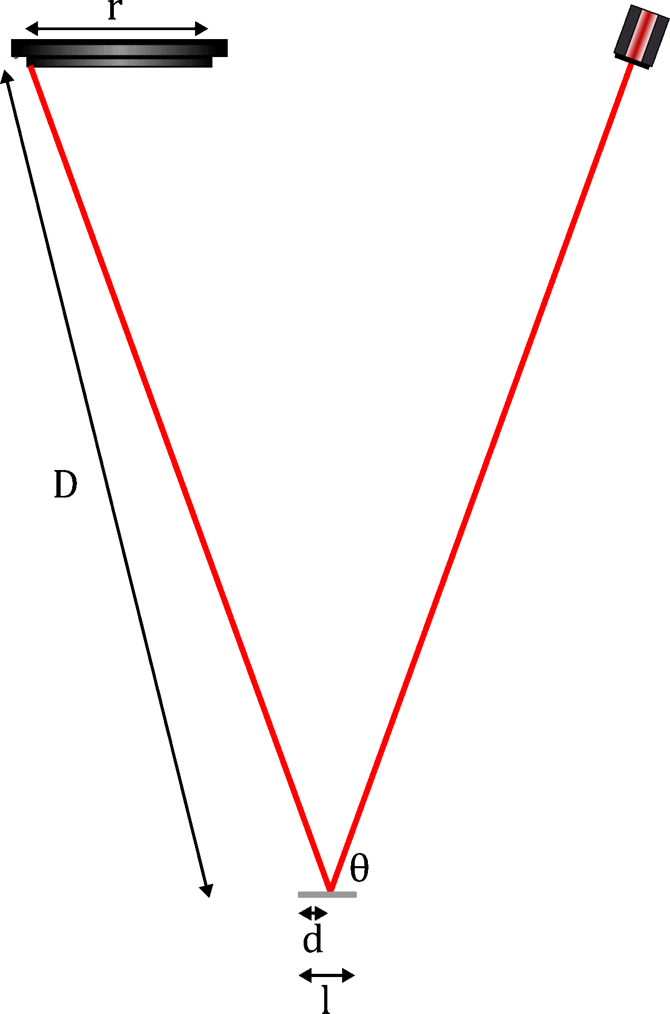
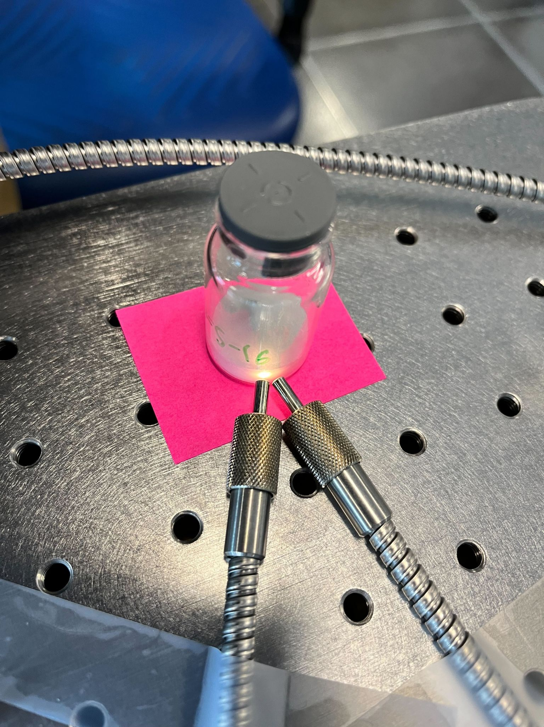
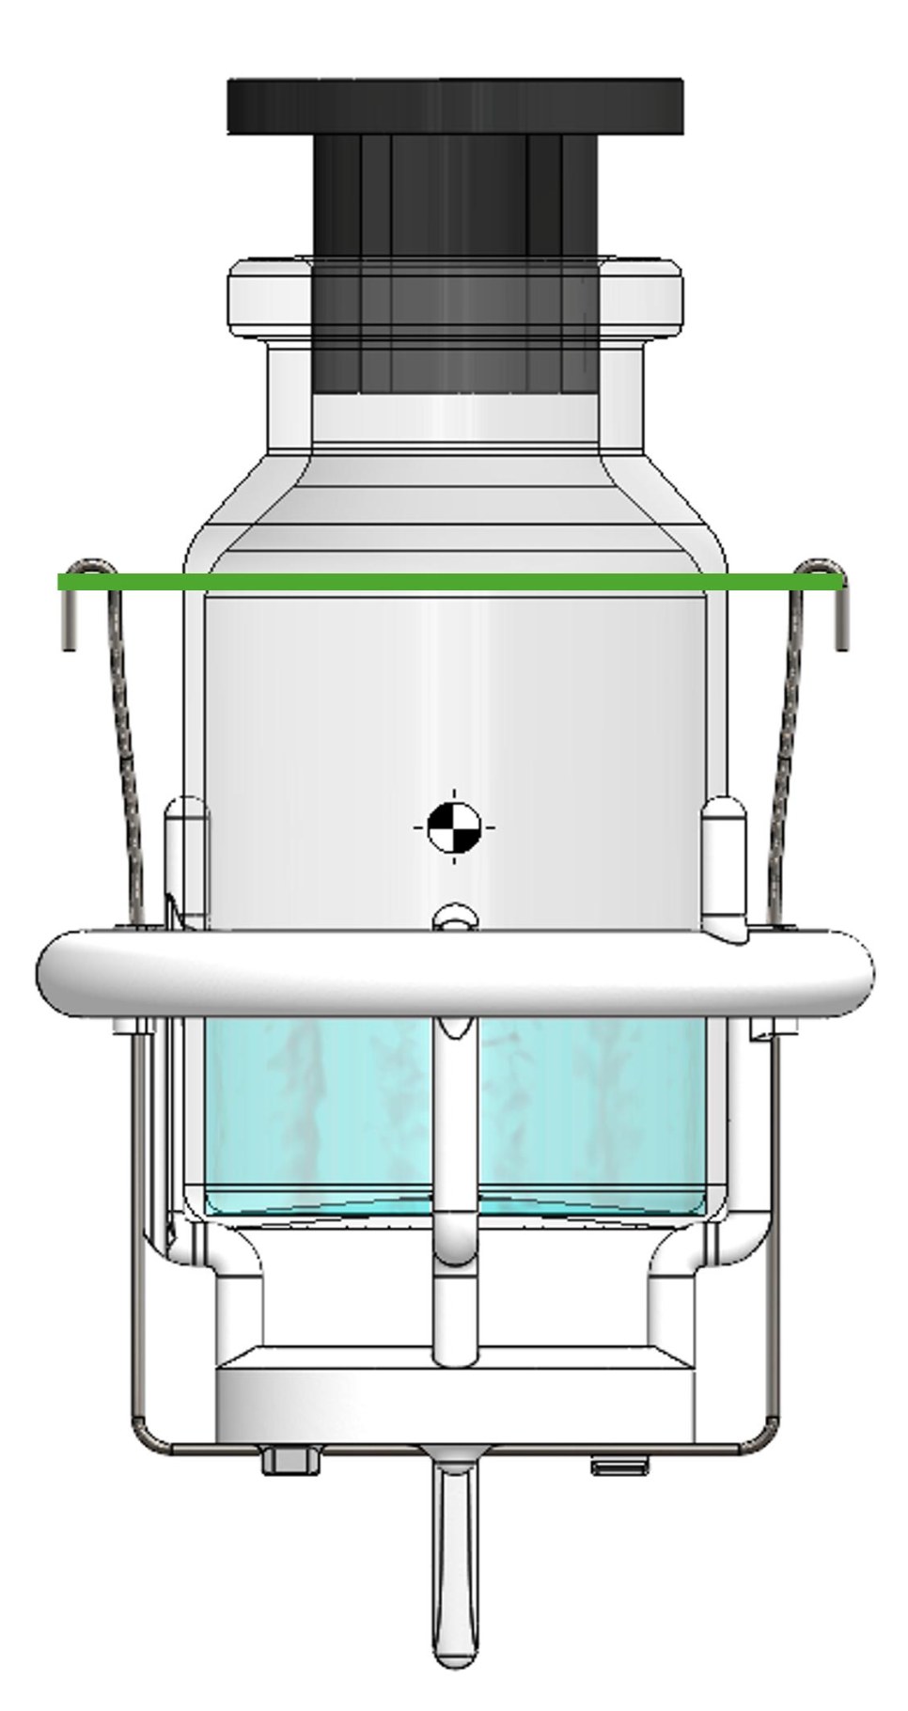
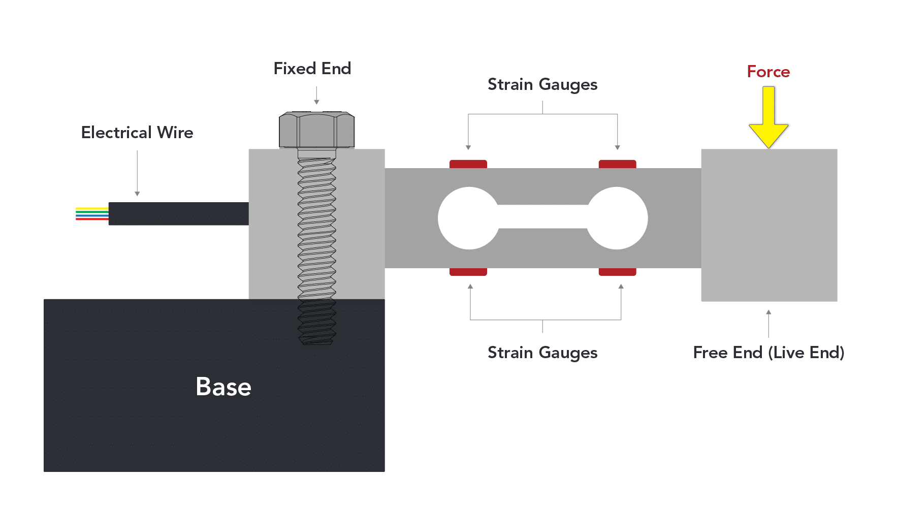
Explored Strategies
Spectroscopy
Deflection - Distance
Deflection - Angle
Water mass change not precise nor accurate enough
To deflect enough to detect a 1mg change, the beam would break until other loads
Promising, by adjusting distance, could get precision required for 1mg

Slide 8
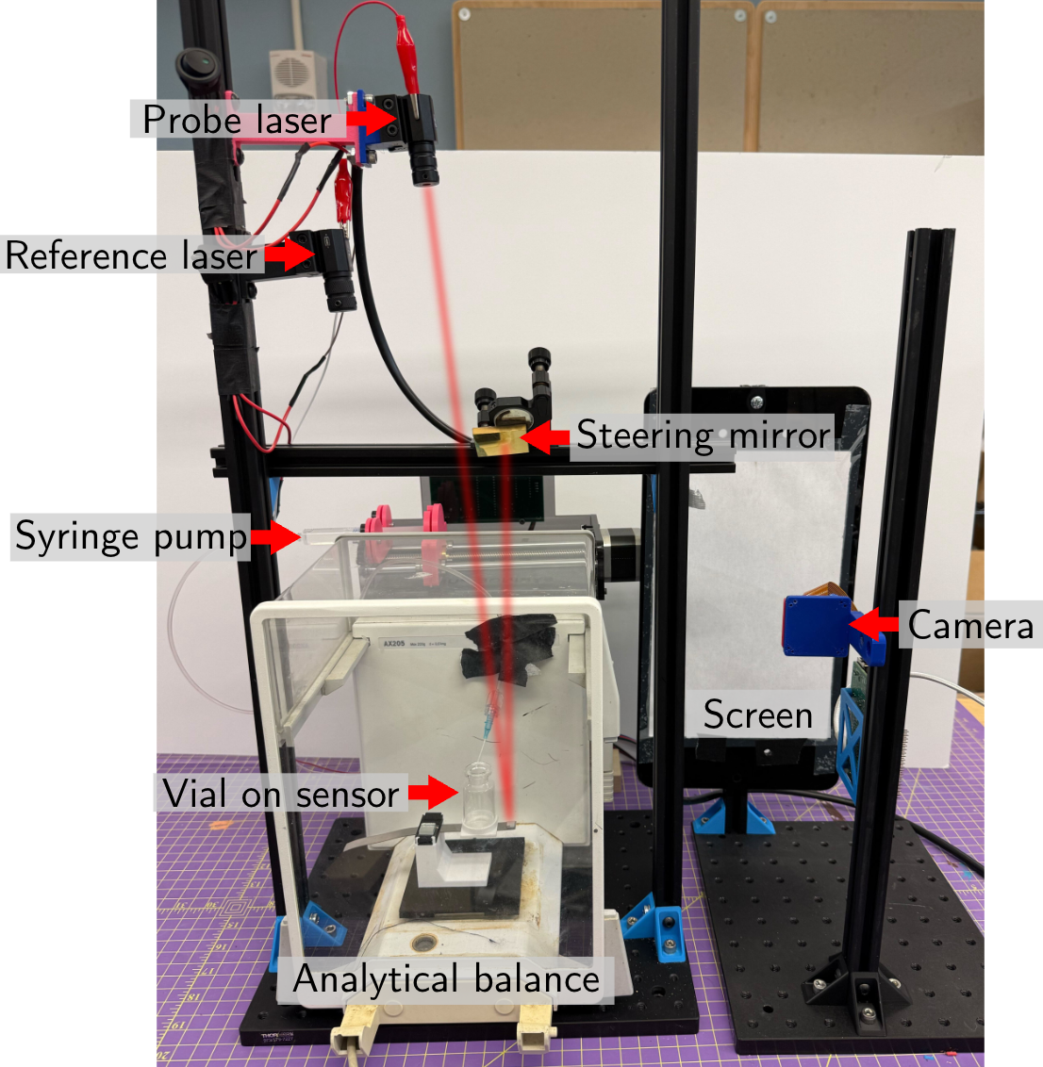
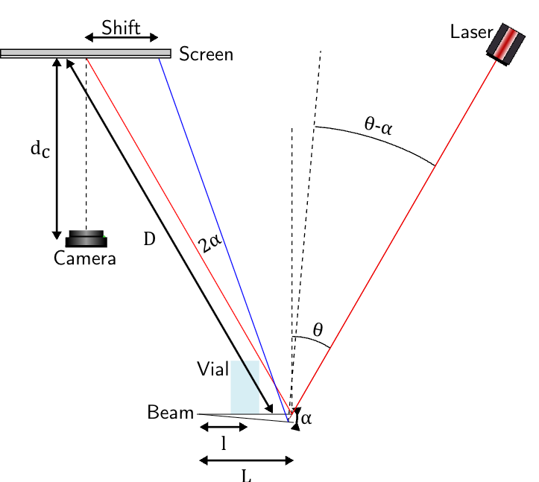
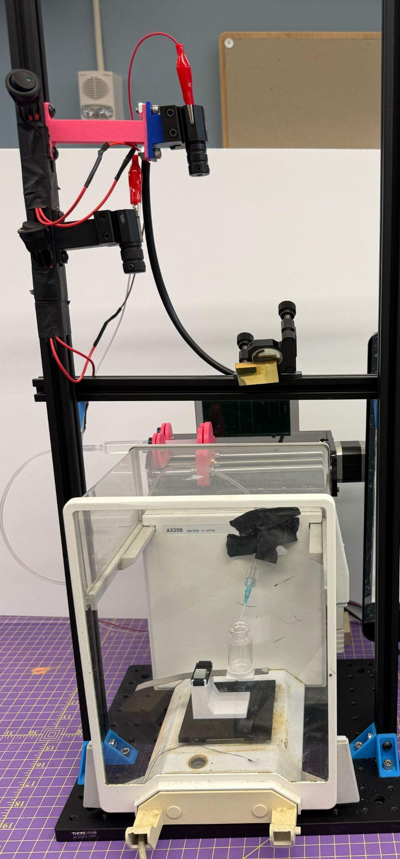
System Overview
Laser
Screen/Wall
Mirror
Camera
Vial
Mirror
Cantilever Beam

Slide 9
Our optical lever amplifies small changes in vial mass
Laser
Screen/Wall
Mirror
Camera
Amplified Displacement
Vial
Mirror
Cantilever Beam
Original Displacement
Notes:
As the water content decreases, loading changes, and mirror angle also changes. This change is amplified by the length of the optical laser path and seen by the camera

Slide 10
Our optical lever amplifies small changes in vial mass
Laser
Image Processing
Screen/Wall
Mirror
Camera
Amplified Displacement
Cantilever
Vial
Mirror
Cantilever Beam
Original Displacement

Slide 11
Our optical lever amplifies small changes in vial mass
Laser
Image Processing
Screen/Wall
Mirror
Camera
Amplified Displacement
Cantilever
Vial
Mirror
Cantilever Beam
Original Displacement

Slide 12
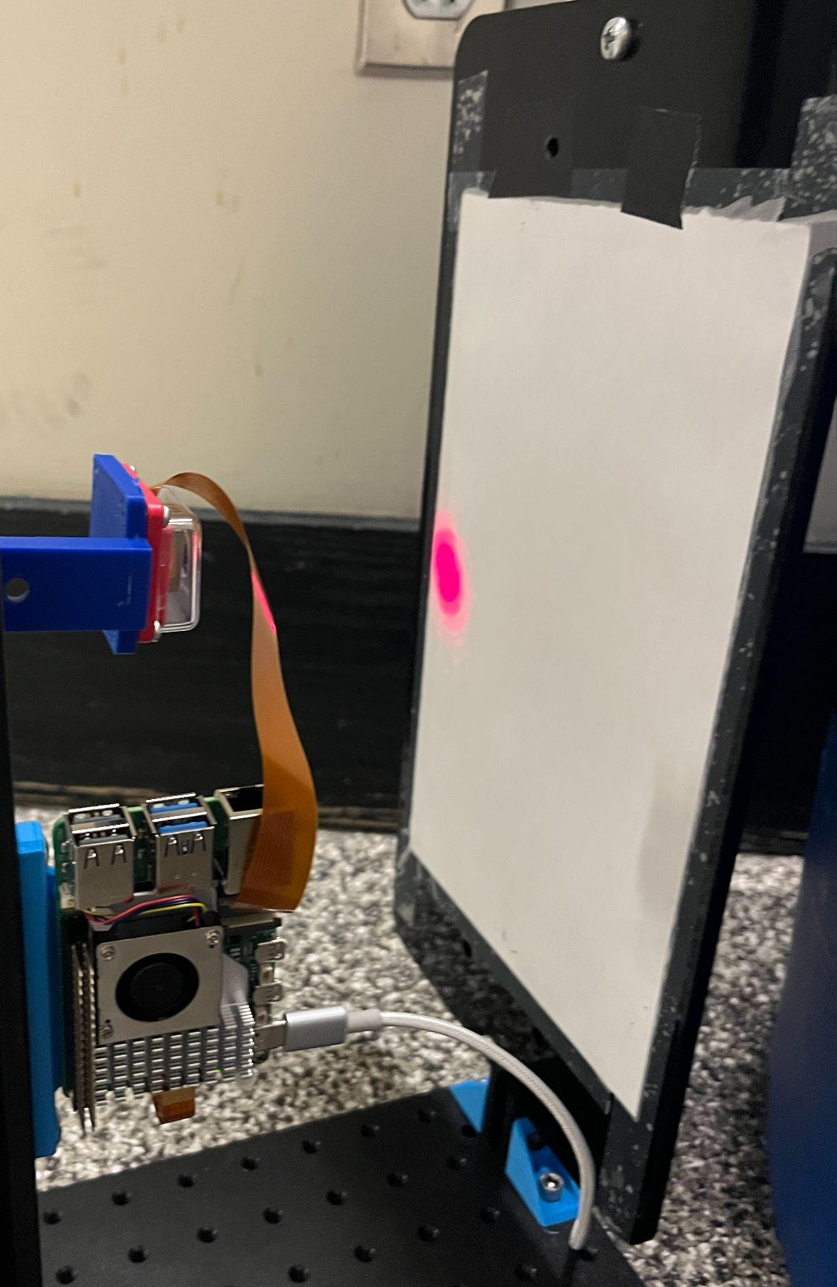
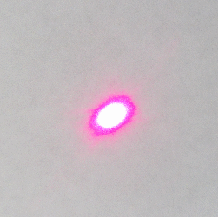
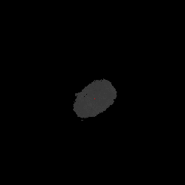
The image processing module captures laser spot displacement
Goal: 1mg sensitivity
Camera: 9248×6944 pixels resolution → laser spot needs to move at least xx per milligram to detect change in laser spot location
Laser spot must move at least xx per milligram for 64mp camera to detect change
Setup
Camera View
Camera
Laser spot
-
=
Image with spot
Image without spot
Spot location

Slide 13
Our optical lever amplifies small changes in vial mass
Laser
Image Processing
Screen/Wall
Mirror
Camera
Amplified Displacement
Cantilever
Vial
Mirror
Cantilever Beam
Original Displacement

Slide 14
Our optical lever amplifies small changes in vial mass
Laser
Image Processing
Screen/Wall
Mirror
Camera
Amplified Displacement
Cantilever
Vial
Mirror
Cantilever Beam
Original Displacement

Slide 15
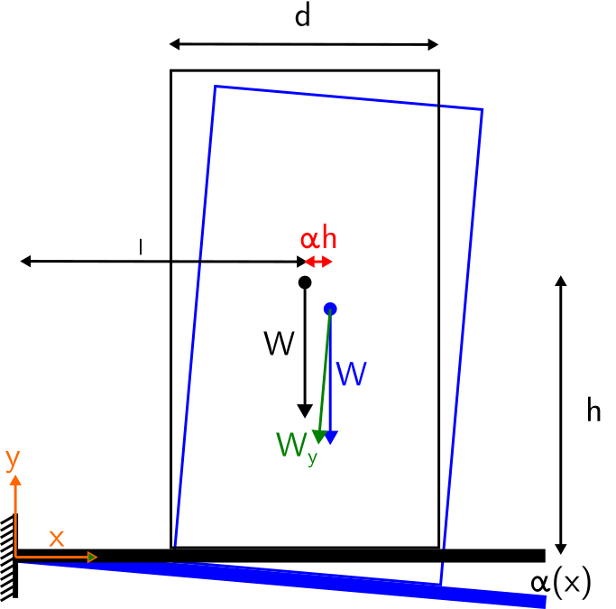
The cantilever achieves the desired deflection
Cantilever: needs to deflect xx per milligram, can be a maximum of xx width xx length → determined cantilever geometry to achieve desired deflection (below max stress)
Simplified Model
Beam design
Deflects ~100 nm per mg
while staying within elastic deformation region and fitting within geometric boundaries
304 Stainless Steel (E = 193 GPa)
w = 10mm
t = 0.2mm
l =35mm
Extra term!
Usual terms
Usual beam’s equation
Notes:
100 nanometers is the length of a virus

Slide 16
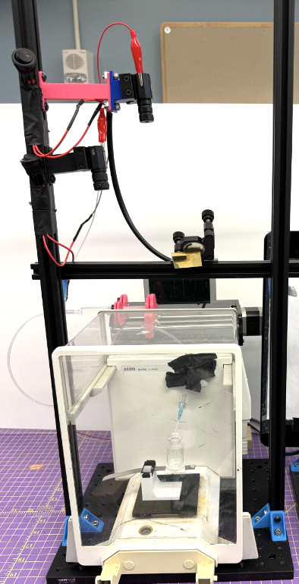
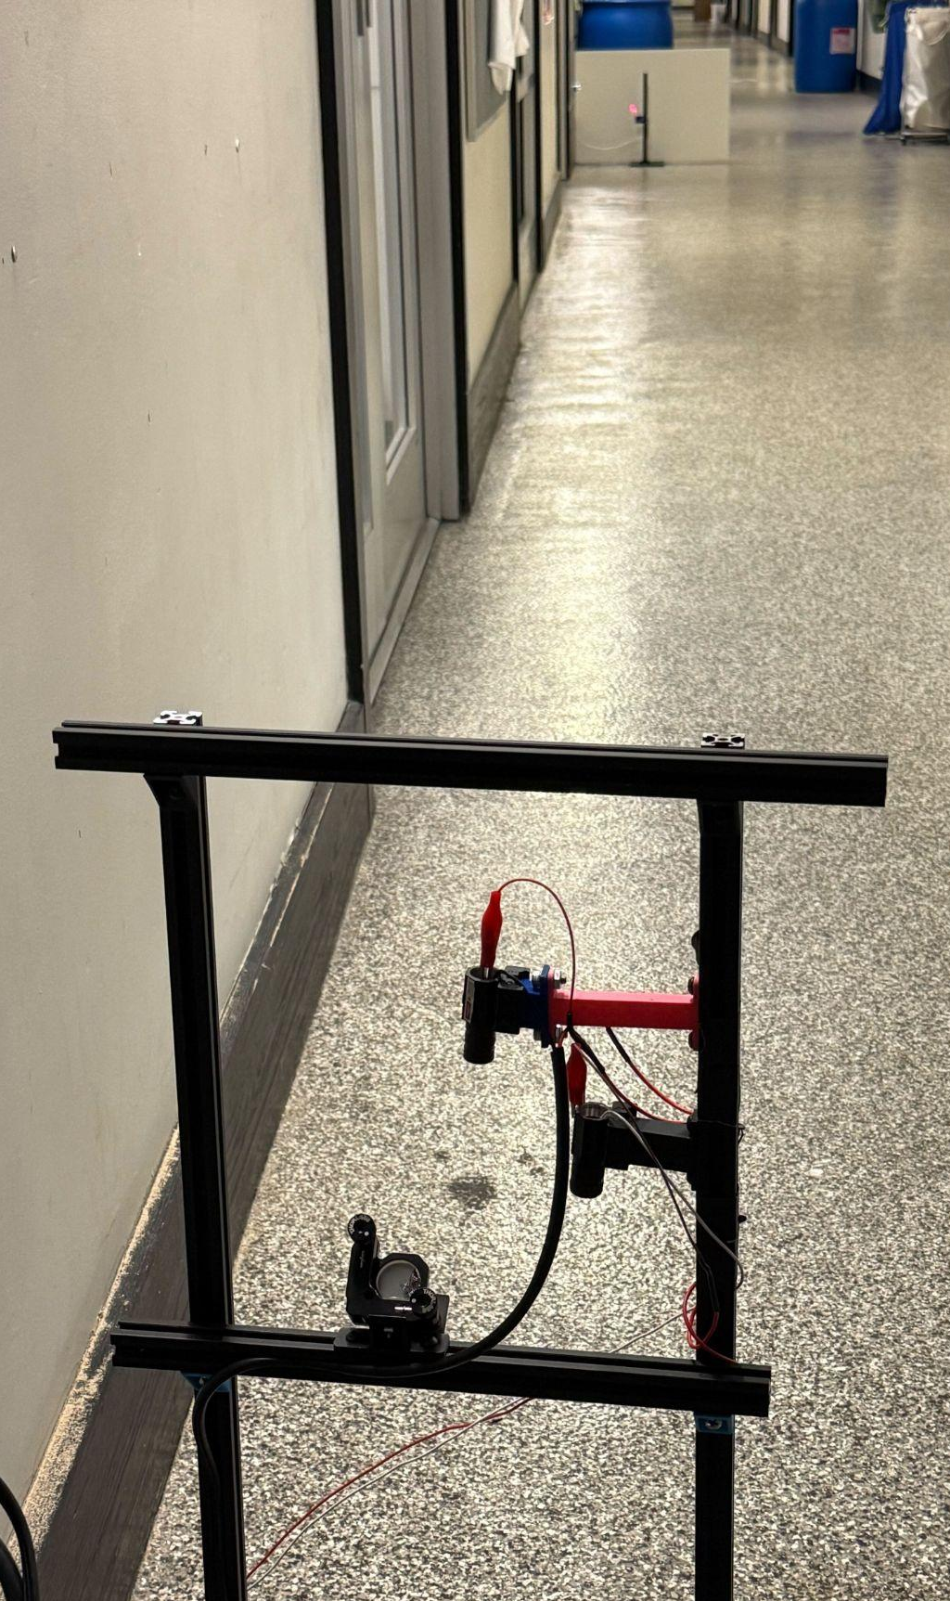
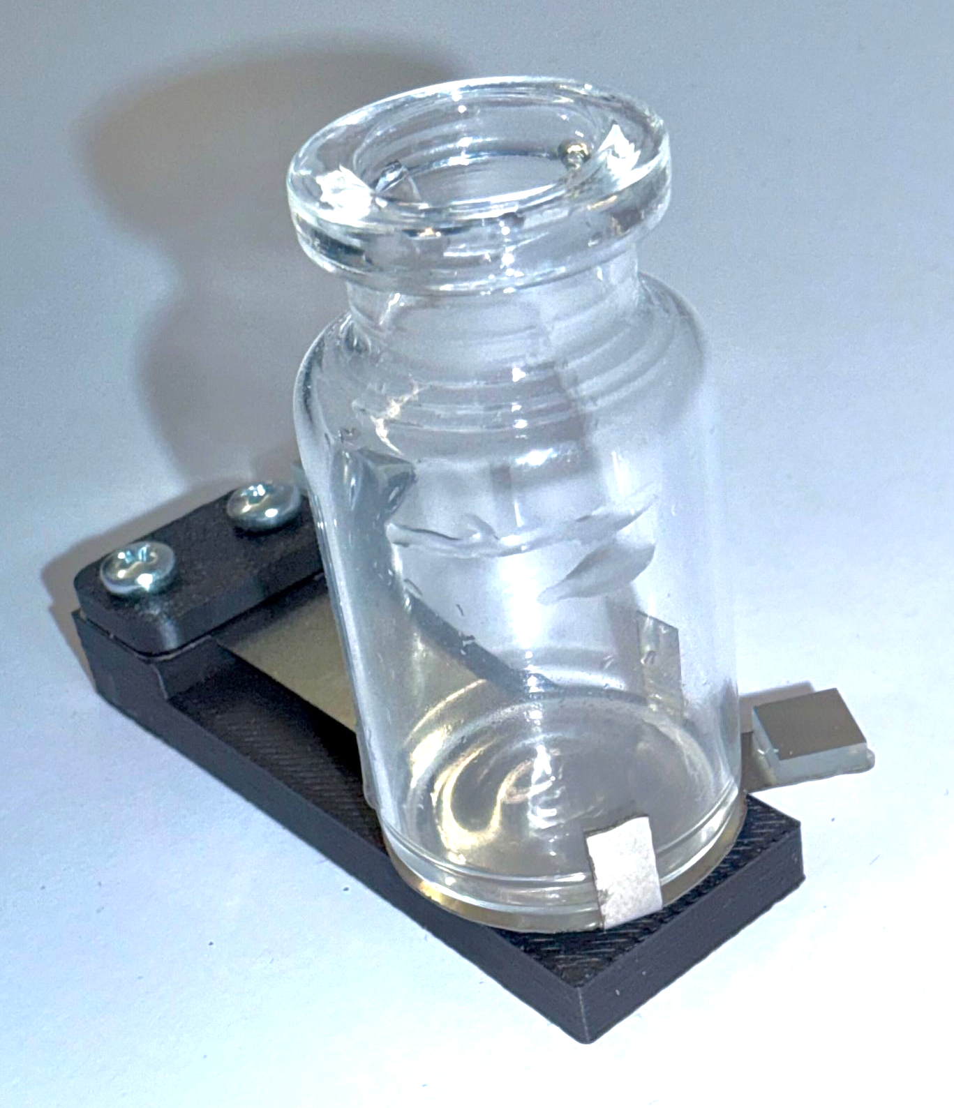
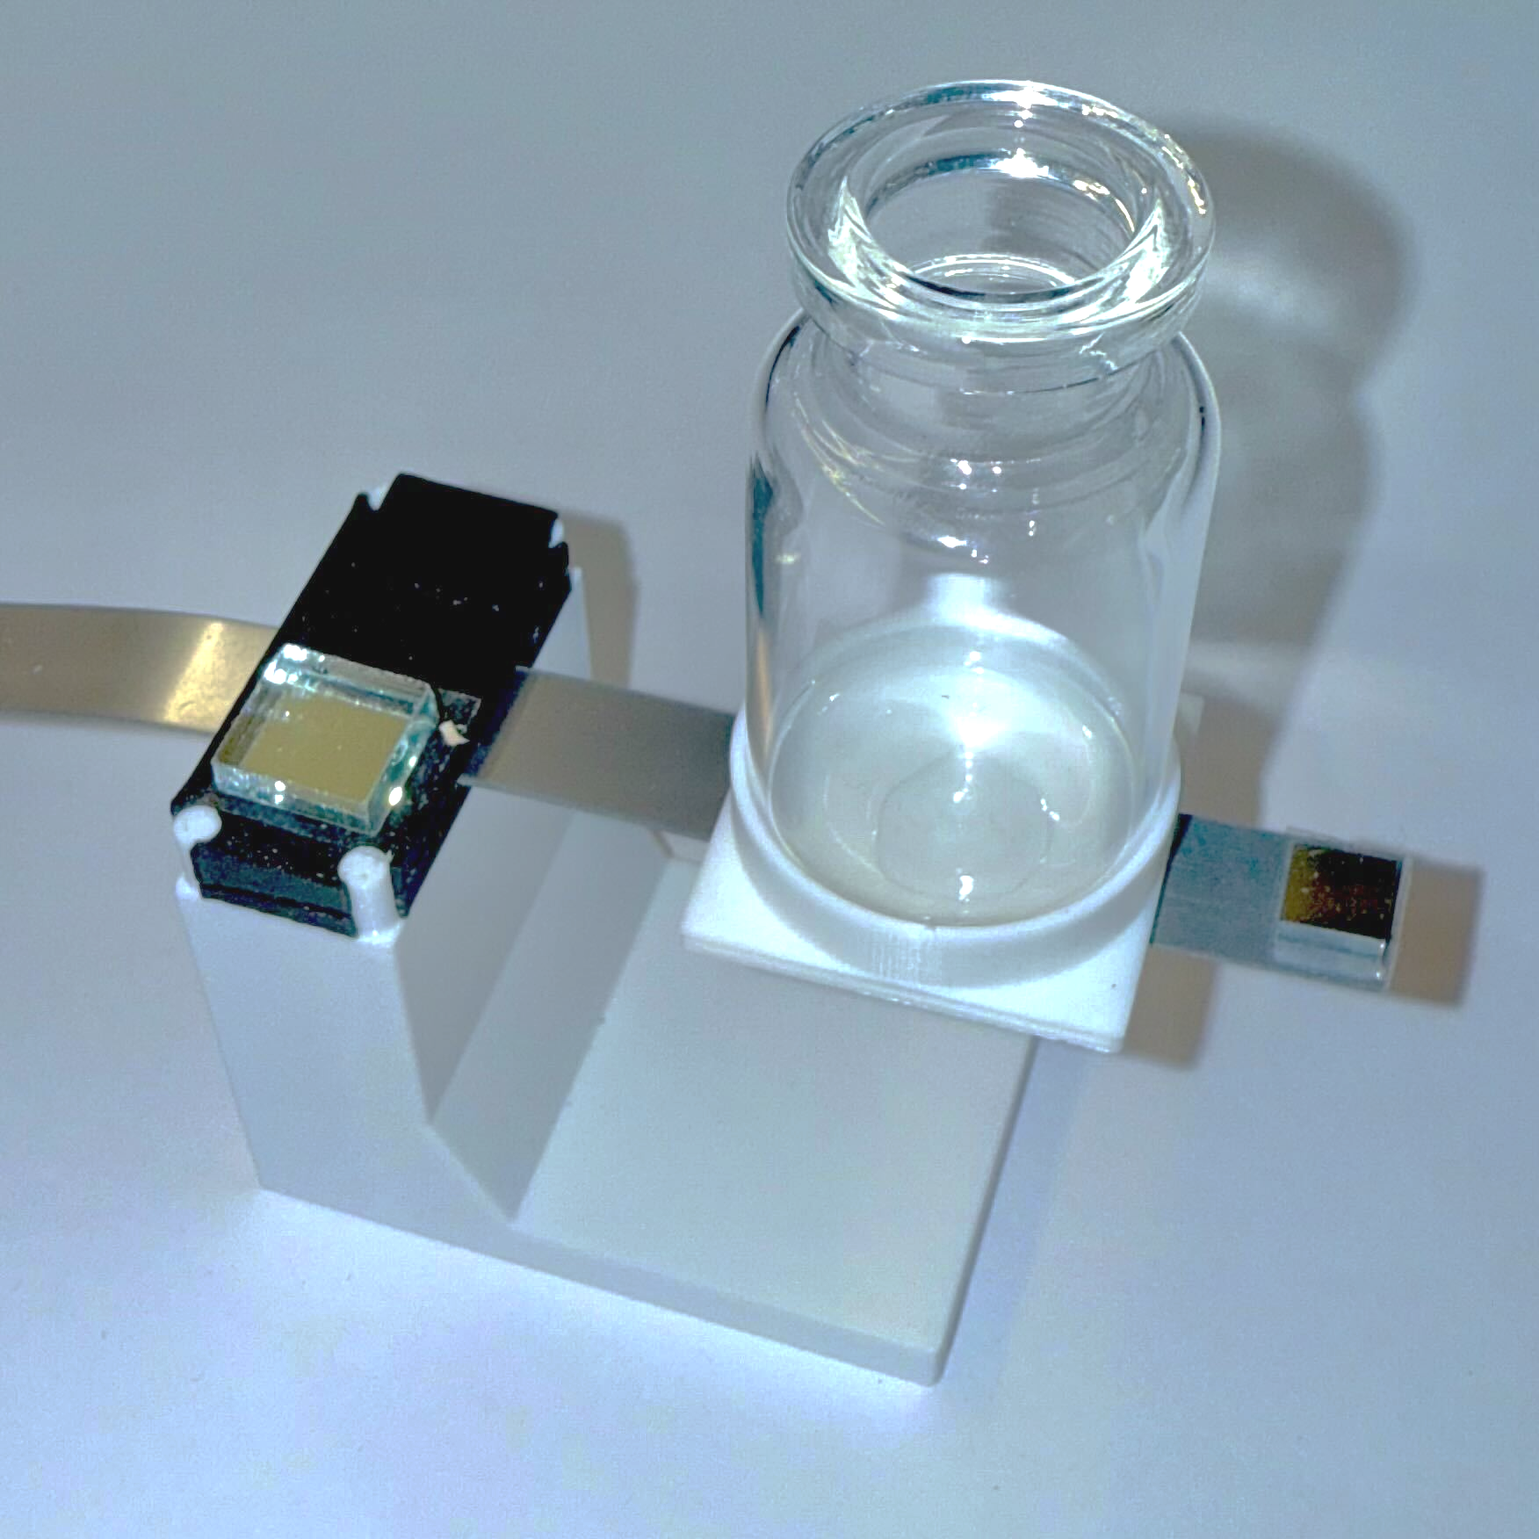
Testing Setup and Fabrication
Main Frame
Target & Long Hallway
Cantilever
Laser
Camera & Screen
Steering mirror
Mirror
Syringe pump
Waterjet Stainless Steel Shim
3D Printed Base
Analytical balance
Notes:
Q: How were risks addressed with countermeasures?
A: We reduced noise by moving the setup to the ground, blocking air flow, trying several sources of “ground truth mass”

Slide 17
Our system achieves near-milligram accuracy and repeatable measurements over multiple loads
Leave-one-out cross-validation:
Benchtop configuration (D~0.6m)
Slope | 6.126 ± 0.005 g/mm
Mean RMSE | 4.45 mg
3 sigma | 2.22mg

Slide 18
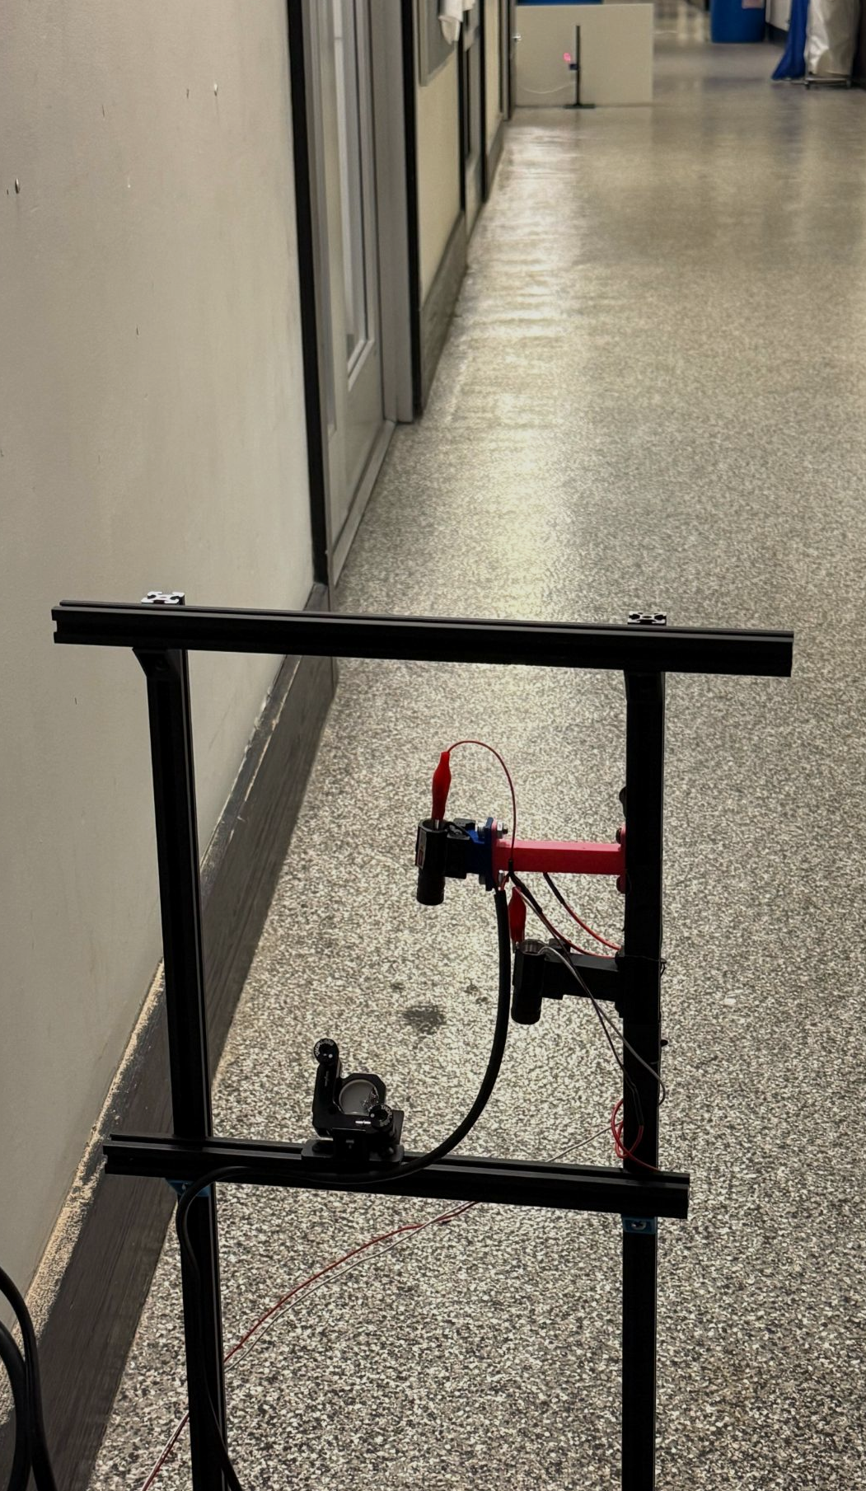
Increasing optical path length increases sensitivity
Laser spot
Distance D (m) | Lower bound resolution (mg) | RSME (mg)
0.6 | 5.1 | 5.50
1.3 | 2.4 | 3.02
14.3 | 0.22 | 1.12
14.3 | 0.22 | 0.62
Distance
D
Vial holder
Briefly address why the fit is quadratic bc some ppl will wonder
Some explanations of the statistics and zooms in of the graph

Slide 19
Limitations & Improvements
Limitations | Improvements
Ground-truth mass readings drift | Calibration with professional 6-digit scale
Prototype uses 3D printed materials and double-sided tape | Precision manufacturing with quality materials
Ambient vibrations cause noise | Vibration reduction with magnetic damping
Optical lever requires long distance increasing footprint | Use an optical cavity to maintain optical path length while reducing footprint
Calibration procedure performed out of lyophilization machine | Conduct testing under lyophilization conditions
Notes:
Better scale / ground truth
Precision manufacturing with quality materials
The things we talked about on wednesday about bolt selection and placement
Reduce footprint by using the off the shelf laser path length instrument
Potentially reduce vibrations with damping system

Slide 20
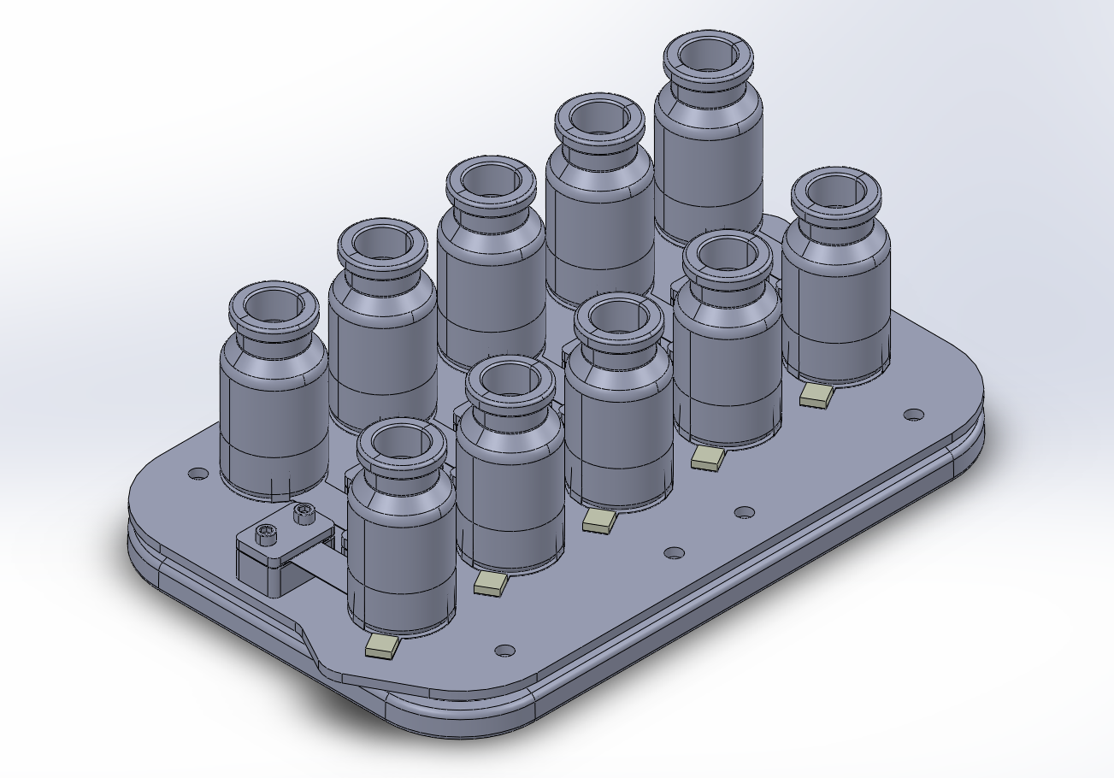
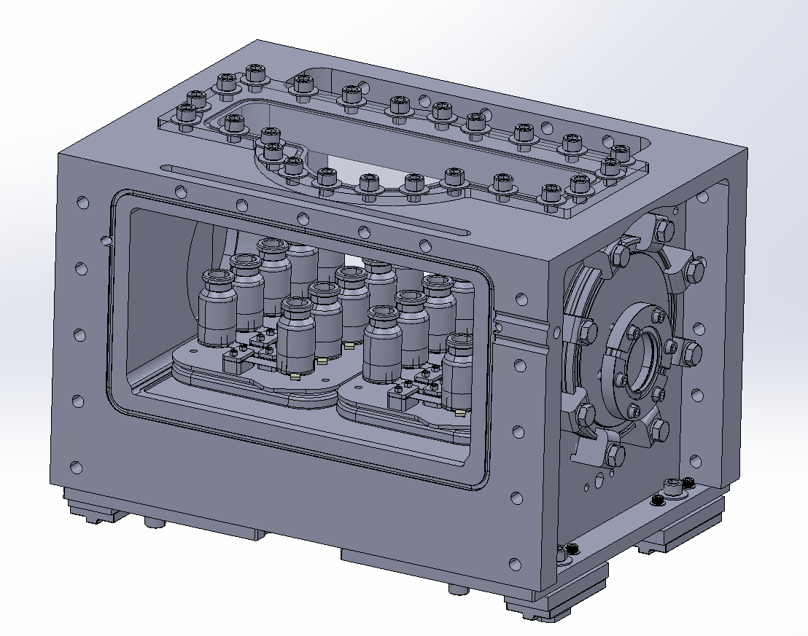
Integration with continuous Lyo machine
Laser path
Maglev Plate
Individual sensors
Lyo Chamber
Notes:
As one of our requirements was physical compatibility, we show that we can place the same amount of vials on the maglev plates as previous within the lyophilization chamber. The chambers also have viewport for the laser on top.

Slide 21
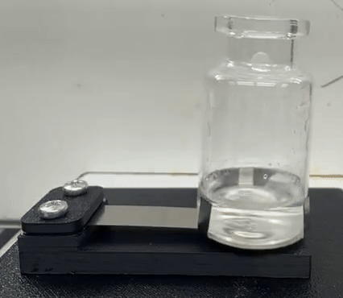
Takeaway
Integrated into commercial drug manufacturing, our device has the potential to improve throughout and reliability in extending shelf life of drugs by providing more control over the manufacturing process
Notes:
Having shown alignment with all functional requirements, our design, when integrated into commercial drug manufacturing, our device has the potential to extend shelf life of drugs by providing more control over the manufacturing process

